Slide 1
C for Java Programmers

Slide 2
So Where Are We Now?
We’ve taken apart a computer from the circuit level to the assembly-language level (and it’s not even mid-term)!
We know how to work those pieces
We’re ready to talk seriously about problem-oriented languages

Slide 3
Problem-Oriented Language
A language whose statements resemble terminology of the user application-oriented language rather than machine language. In other words a language in which algorithms are expressed in human terminology (math, science, business) as opposed to machine implementation terms.
There have been and are lots of them.

Slide 4
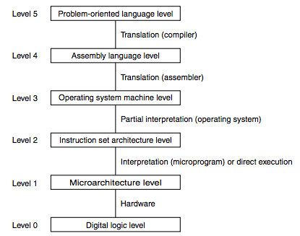
One More Abstraction…
These days, we even have abstraction layers within the problem-oriented language layer
Object-oriented Languages
(Java fits here)
Procedural Languages
(C fits here)

Slide 5
Making Things Simpler?
Give Symbolic Names to Values
Provide Expressiveness
Abstract the Underlying Hardware
Enhance Code Readability
Provide Safeguards Against Bugs

Slide 6
Generations
Ancestors
Fortran
Algol 60
PL/I
Parents
(CPL, BCPL, B) -> C
Descendents
Perl
Java
Python
C++
C#

Slide 7
The C Language
BCPL (Typeless) - 1967 - Operating Systems
B - Ken Thompson - First version of Unix
C - 1972 - Dennis Ritchie - Implemented on PDP-11
Unix rewritten in C in 1974
Publication in 1978 of "The C Programming Language" by Brian Kernighan and Dennis Ritchie
...
ANSI C (1989)
Major updates to C standard in 1994 and 1999
We will use C99 in CS 2110 (GNU C compiler)

Slide 8

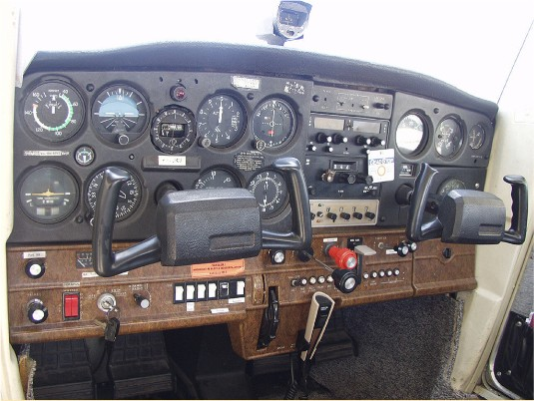
Learning to Program
CS1

Slide 9

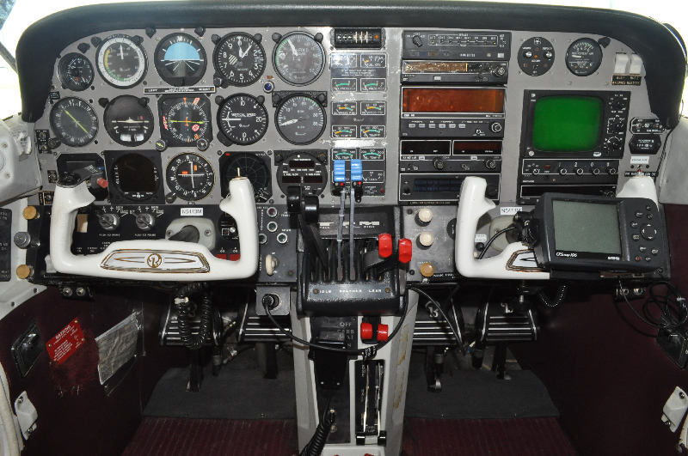
Learning to Program
CS2

Slide 10


So We’re Ready for a Fast, Modern Jet, Right?
CS2110

Slide 11
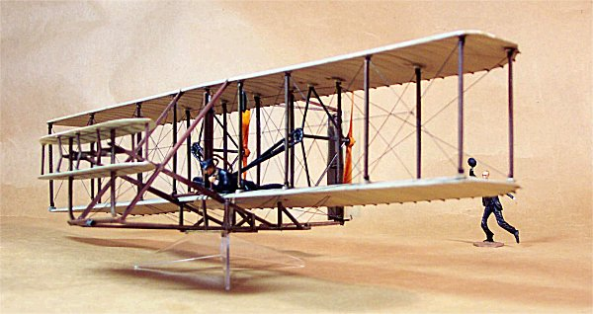
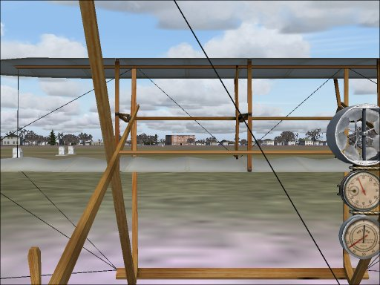
Well, C is More Like…
CS2110

Slide 12
C
C is the language that will allow you to do anything.
It is used to write operating systems, other languages, low level hardware drivers, cryptography, networking, etc.
It was designed to be easily compiled and to product compact, efficient code
It won't check for many runtime errors
Remember: It was invented to implement system software for a small computer

Slide 13
C
Is not your friend. Or rather C is very particular about who its friends are…
C trusts you and will do exactly what you ask: It is quite certain you are a careful, knowledgeable programmer
All the symbols mean something!
"I'll just type something in and the compiler will fix it for me” just won't work
Read and reread the C book! And there are plenty more tutorial resources on the net

Slide 14
Languages
Many problem-oriented programming languages have features that try and prevent the programmer from doing something wrong or letting him know when he does, e.g.
Java does not allow you access memory by address
Java throws an exception when you have an array out of bounds
C is not one of these languages. Why?

Slide 15
Learning a New Language
There are lots of commonalities among high-level programming languages
Look at these three areas first:
Variable scoping
Storage allocation
Function call semantic

Slide 16
Differences Between Java and C
C is about 45 years old and pre-dates Java by about 25 years
C is procedural; no object-oriented abstraction layer is present
C structs are used in place of classes; unions help support polymorphism
Pointers are used in place of object references
No overloading of function names; each function must have its own name
Limited support for complicated run-time operations; library functions are used instead

Slide 17
Design Goals
Year | System |  | CPU | RAM | Disk
1972 | PDP-11 | $200,000 | 1 MHz | 64 KB | 8 MB
2018 | X86 server | $2,000 | 3 GHz | 16 GB | 8 TB
 | Factor | 0.01 | 3,000 | 250,000 | 1,000,000
Incur as little run-time overhead as possible
Skip constructs that can’t be implemented by a few machine instructions
Use as little run-time memory as possible
Don’t add additional fields to programmer’s definitions
Don’t automatically drag in huge run-time libraries
Make the system’s memory accessible to privileged programs
Keep the compiler small enough to fit in memory and still have room for a symbol table

Slide 18
Storage Differences
C scopes data names by file, similar to Java
C integer datatypes: char, short, int, long, long long; all can be unsigned
Promotion/demotion among integer datatypes and among floating datatypes doesn’t require a cast (but will generate a gcc warning)
Promotion/demotion can lose significant figures
C Strings are character arrays with a terminating “\0”; no special language support is provided, but many library functions are provided
C and Java both store local variables in the stack and dynamic structs/objects in the heap.

Slide 19
Expression and Control Statement Differences
Expressions are very similar
All expressions (including assignments) yield a value.
Order of precedence is the same
No “new” ,“instanceof”, or >>>
Added are “sizeof”, unary &, unary * and binary ->
Control statements are quite similar
Old friends “if”, “while”, “do-while”, “for”, “switch”, “break”, “continue”, “return”

Slide 20
More Differences
C has no built-in package, thread, exception handling, or garbage collection mechanisms
Program files are compiled separately to machine code and linked together with libraries using a link editor (linker)
C does no runtime bounds checking!
C implements I/O, heap management, math functions, etc. through functions (supplied by C Standard Library), i.e. there’s no support in the language itself
The C preprocessor manipulates the text of the source program before it’s compiled

Slide 21
A Quick Example
#include <stdio.h>
#include <stdlib.h>
int nfact(int n);
int main(int argc, char *argv[]) {
int a, f;
a = atoi(argv[1]);
f = nfact(a);
printf("%d! = %d\n", a, f);
return 0;
}
int nfact(int n) {
if (n < 2)
return 1;
return n * nfact(n - 1);
}

Slide 22
The C Compiler
C Source Files
and Header Files
C Preprocessor
Preprocessed
Source Code
Compiler
Source Code
Analysis
Symbol
Table
Target Code
Synthesis
Object
Module(s)
Object Files
Linker
Library Object
Files
Executable Image

Slide 23
C
Source
Code
Preprocessed
Source
Code
C
Source
Code
Preprocessor
Preprocessed
Source
Code
C
Source
Code
Preprocessed
Source
Code
Object
File
Object
File
Object
Files
Machine
Language
Executable
Program
Compiler
Linker
Library
Files
Library
Files
Library
Files

Slide 24
Machine
Language
Executable
Program
(Linux)
Loader

Slide 25
Running Our Example
$ gcc example1.c
$ ls
example1.c a.out
$ ./a.out 6
6! = 720
$ ./a.out 7
7! = 5040

Slide 26
Useful Websites
http://www-ccs.ucsd.edu/c/
http://cslibrary.stanford.edu/
http://www.cprogramming.com/

Slide 27
Getting Ready for HW 8
We’re going to introduce several topics that you’ll need to complete Homework 8.
You are going to take the terms and examples we present and look them up in K&R, Patt, and/or the internet to get clarification if you need it.
Then, after Homework 8 is started, we’ll come back and look at some of these topics in more detail.

Slide 28
What We Need for HW 8
We’ll do these topics first:
Scopes
Data types
Strings
Structs and Typedefs
Pointers
Dynamic storage
Printf()
C preprocessor
A good example

Slide 29
A. Scopes
Functions can’t be nested
Name scopes are based on where names are declared and describe where the names can be seen (used)
Ranges of the scopes are global (everywhere), within the file, the function, and the block (i.e. not much different from Java)
Names must be declared before first use
The global scope is influenced by the use of static and extern storage class keywords (more on that later)

Slide 30
B. Data Types
Integer types
[unsigned] char 8 bits
[unsigned] short [int] 16 bits
[unsigned] int 16/32 bits
[unsigned] long [int] 32/64 bits
[unsigned] long long [int] 128 bits
Pointers (a special kind of integer)
Floating point types
float 32 bits
double 64 bits
long double 128 bits
Aggregate types
struct
union
Array

Slide 31
How Big? It Depends.
It depends on your platform
char – at least 8 bits
short int – at least 16 bits
int – at least 16 bits
long int – at least 32 bits
You can tell with sizeof
sizeof is a compile-time constant reflecting the number of bytes held by a data type or instance
sizeof(char) <= sizeof(short) <= sizeof(int) <= sizeof(long)
sizeof char is 1.

Slide 32
C. Strings
Strings are arrays of characters and end with an ASCII NUL (a.k.a. 0 or ‘\0’)
You can define them like this char mystr[6];
You can initialize them several ways char mystr[6] = { ‘H’, ‘e’, ‘l’, ‘l’, ‘o’, ‘\0’ }; char mystr[] = { ‘H’, ‘e’, ‘l’, ‘l’, ‘o’, ‘\0’ }; char mystr[] = “Hello”;
The latter two are special cases in which the C compiler determines the length of the array from the initializer
There are a number of library functions for dealing with strings, including strlen(), strcpy(), and strdup()

Slide 33
D. Structs and Typedefs
Structs look at lot like classes in Java – they are aggregate data types
They contain no methods and all members are publicly visible
Whether members are started at 2/4/8/16 byte boundaries is implementation dependent
struct a {
int a, b;
char c[4];
int d;
} astruct;
a
b
c[4]
d
16 bytes (4x4)

Slide 34
More on Structs
The struct tag declares the type struct car { char mfg[30]; char model[30]; int year; };
Names following the struct tag defines instances of the struct (i.e. allocate storage) struct car mikes_car, johns_car;
You can do both at the same time as on the previous slide

Slide 35
Referencing Structure Members
The . operator is used just as in Java to reference members of a structure printf(“%s\n”, mikes_car.model); strcpy(johns_car.mfg, “Chevrolet”);

Slide 36
Typedef
Typedef is a shortcut that allows you to create a new alias for a type
It does not create a new type
Start the declaration with “typedef” and put the name where you would put the variable name
Don’t let the syntax throw you: It just allows you to create another name for an existing type

Slide 37
Typedef Examples
Define an array of 5 struct a named b: struct a b[5];
Create a type name for an array of 5 struct a typedef struct a sa5[5];
Now we can use sa5 as a type name: sa5 c;
Another example typedef long size_t; size_t position;
What type is c? What type is position? array of 5 struct a; long

Slide 38
E. Pointers
Pointers contain memory addresses (or NULL)
Remember this from LC-3 assembly? B .fill 29 BADDR .fill B
In C, we can write it int b = 29; int *baddr = &b
& is the “address of” operator; you use it to obtain a pointer to an existing data item
Note that these are C initializers. The syntax is a tiny bit different if we use an executable statement

Slide 39
Using Pointers
To reference what a pointer points to, we use the dereference operator *
It acts like “indirect” in LC-3 loads and stores
In LC-3 assembly, if we wanted to use BADDR to access the value in B, we used LDI R1,BADDR ; get B ADD R1,R1,#2 STI R1,BADDR ; set B=R1
In C, we can write this as *baddr = *baddr + 2;
It literally does the same thing!

Slide 40
Another Example
Continuing our example with b and baddr,
printf(“%d\n”, b); *baddr = 18; printf(“%d\n”, b); printf(“%d\n”, *baddr);
prints
29 18 18
The value stored at b has been changed to 18; baddr still contains the address of b

Slide 41
* Has Two Meanings!
Don’t let the * in declarations confuse you about executable statements.
In a declaration, * means “pointer to” and is part of the type
In an executable statement, * is the “dereference” operator – it acts like the “indirect” in the LC-3 loads and stores
When applied to a pointer, * makes the expression mean “What this pointer points to”
Declaration
int *pi = &i;
Statement
int *pi;
pi = &i;

Slide 42
Pointers
Powerful and dangerous
No runtime checking (for efficiency)
Bad reputation
Java has removed many of the features of pointers that cause problems, hence the decision to call them references:
No “address of” operator
No “dereference” operator (always dereferences)
No pointer arithmetic

Slide 43
Question?
int x = 3;
int y = 72;
int *px = &x;
int *py = &y;
*px = 7;
py = px;
x = 12;
printf("%d %d\n", *px, *py);
What is the output?
3 72
72 3
7 12
12 7
3 3
72 72
12 12
12 72
72 12

Slide 44
Another Pointer Operator
C supports the operator ->
The left operand must be a pointer and the right operand a struct member.
It is literally a shorthand for * and . struct { int a, b; } *p; (*p).a = (*p).b; p->a = p->b;
Same meaning

Slide 45
Why Pointers?
They have to be good for something more than aliasing storage we’ve already allocated, right?
What about referencing storage that isn’t defined at compile time?
Many times, the amount of space required is unknown at compile time.
Technically, the C language by itself only supports stack storage (which was a major innovation in 1972)
So what do we do?

Slide 46
F. Dynamic Storage
Example
Need space to allow user to enter some data
80 bytes? 132? 1? 256? 255?
Three Friends from the C library
malloc()
realloc()
free()
These friends create and manage a heap for us

Slide 47
malloc()
struct r {
char name[40];
double gpa;
struct r *next;
} *rp;
rp = malloc(sizeof(struct r));
if (rp == NULL)
{
/* Handle Error! */
}
Options for handling error
Abort
Ask again
Save user data
Ask for less
Free up something
Stack
rp
Heap
48 bytes
Data
Code

Slide 48
Don’t Do This!
ip = malloc(sizeof struct r);
Code foolishly inserted here!
if(ip == NULL)
Be afraid.
Be very afraid!

Slide 49
Idiomatic But Safe
if((ip = malloc(sizeof struct r)) == NULL)
{
/* Handle Error Here */
}
This is the way it’s done in real life.
Don’t mix up the = and == operators!

Slide 50
Escape From Type-Checking
malloc() returns a pointer to at least as many bytes as we requested.
But what is the type of this pointer and how do we use it to store items of a different type?
malloc() is declared as “void *malloc(unsigned long)”
C uses the idiom “pointer to void” for a generic pointer
To be safe, you should cast this pointer into the correct type so that type-checking can work for you again! int *ip; ip = (int *)malloc(sizeof int);
Otherwise, the compiler will silently cast your “void *” pointer into any other kind of pointer without checking

Slide 51
Done With Storage
When you’re done with a chunk of storage, you use free() to make it available for reuse.
Remember, C doesn’t do garbage collection
From our previous example free(rp); returns the storage for re-use
You mustn’t use the value in rp after the call to free(), nor may you use the memory it points to!

Slide 52
Pointer Video
https://www.youtube.com/watch?v=5VnDaHBi8dM

Slide 53
G. printf()
Printf() is a function in the Standard IO Library (so you need to #include <stdio.h>)
The first argument is a format string
Characters in the format string are copied to standard output
Format codes beginning with % reference arguments that come after the format string, in order

Slide 54
Printf() Format Codes
Some useful format codes are
For example printf(“Person: %s GPA: %f\n”, rec.name, rec.gpa); might print Person: Dan GPA: 2.5
%d | Decimal number (int)
%x | Hex number (int)
%f | Floating number (float)
%s | String (char *)
%c | Character (char)
%p | Pointer (for debugging)

Slide 55
H. The C Preprocessor
The C preprocessor does four things
File inclusion (i.e. processes “#include”)
Macro expansion
Conditional compilation
Code line identification
For now, let’s just look at the first two

Slide 56
#include
Conventionally, we only include file that end in “.h”
These consist of declarations (including function prototypes) and macro definitions but no executable code
If you surround the file name with
double quotes, the preprocessor looks in the current directory and then the system directories for the file
angle brackets (<>), it looks only in the system directories

Slide 57
#include Example
#include <stdio.h>
#include <stdlib.h>
#include <unistd.h>
#include ”mydefs.h"
Header files typically contain
Macro definitions
Declarations
Function Prototypes
NOT Code!!!

Slide 58
Macro Processing
Macro processing is just text substitution using some very specific rules
We’re going to need to want to use symbolic names for constants in several places
For example #define NULL ((void *)0) #define MAXWORDLEN 256
These symbolic names are textually replaced in the source code before it is compiled!

Slide 59
Macro Example
Continuing with our last example, char buf[MAXWORDLEN], *cp, i; … if (cp != NULL & i < MAXWORDLEN) buf[i] = *cp;
After the C Preprocessor, it becomes char buf[256], *cp, i; ... if (cp != ((void *)0) && i < 256) buf[i] = *cp;

Slide 60
I. An Example: Word Frequencies
Reference ch 6.5, p. 139 in K&R.
“Suppose we want to handle the […] problem of counting the occurrences of all the words in some input. Since the list of words isn’t known in advance, we can’t conveniently sort it and use a binary search. Yet we can’t do a linear search for each word as it arrives to see if it’s already been seen; the program would take too long. […] One solution is to keep the set of words seen so far sorted at all times, by placing each word into its proper position in the order as it arrives. […] We will use a data structure called a binary tree.
See “wordfreq” in Canvas Files > Source Code

